Slide 1


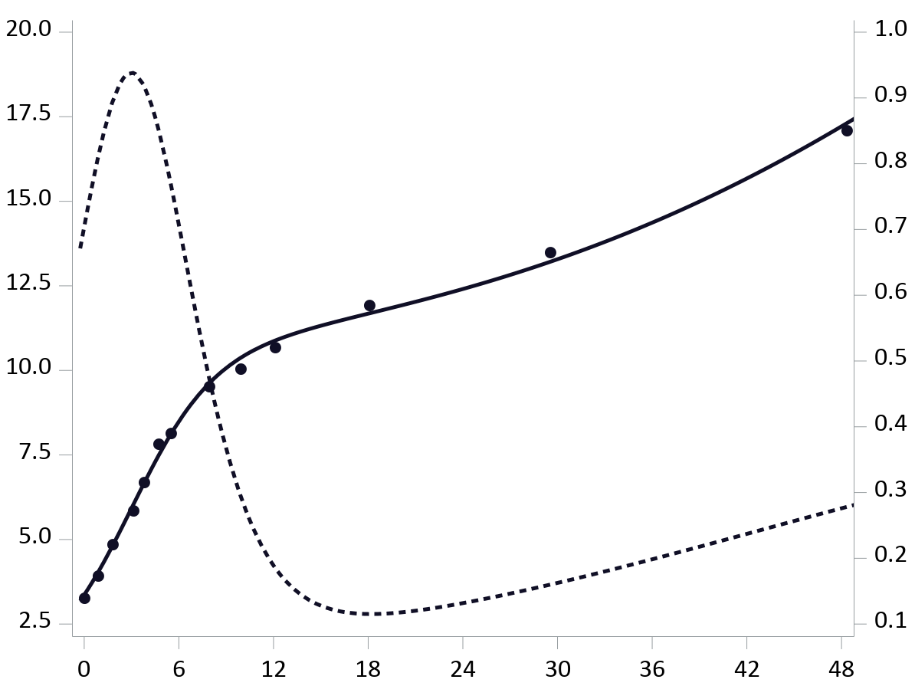
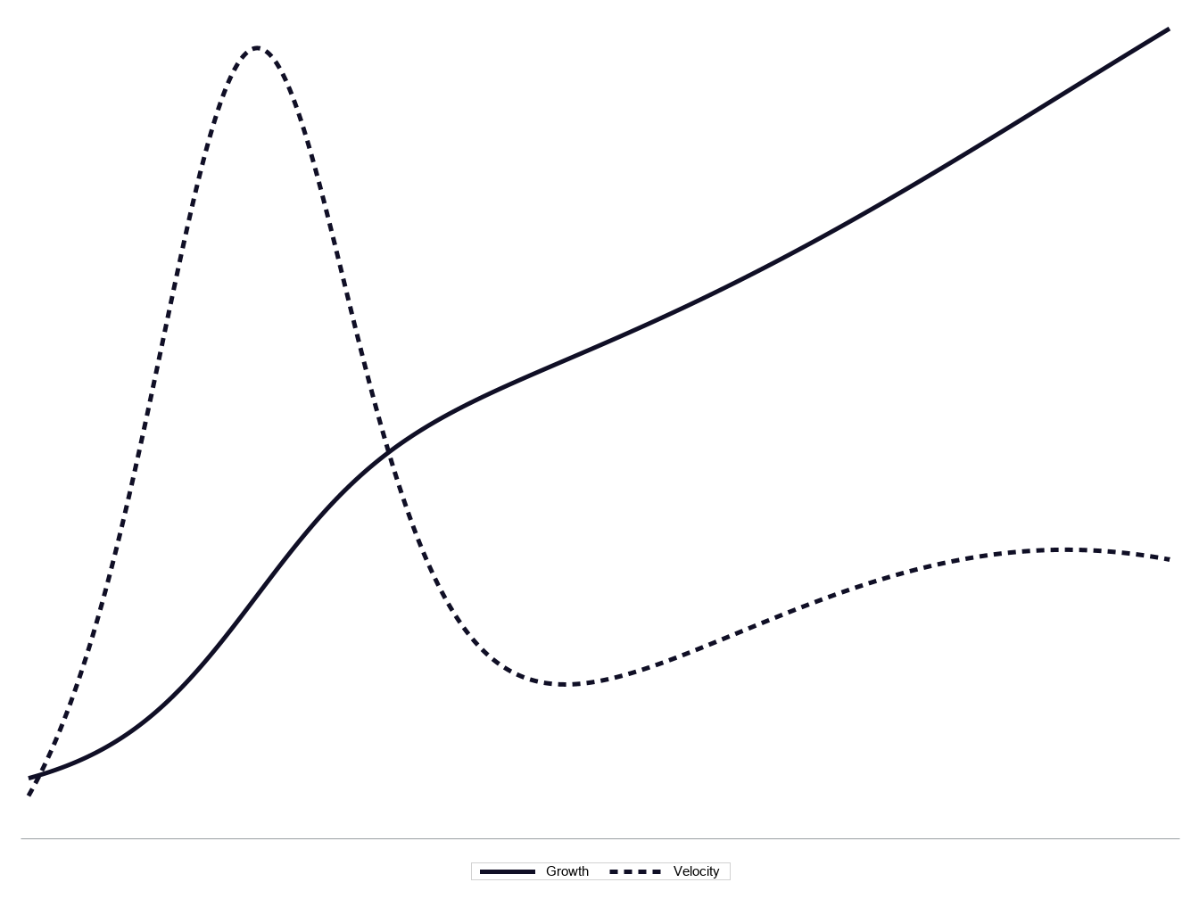
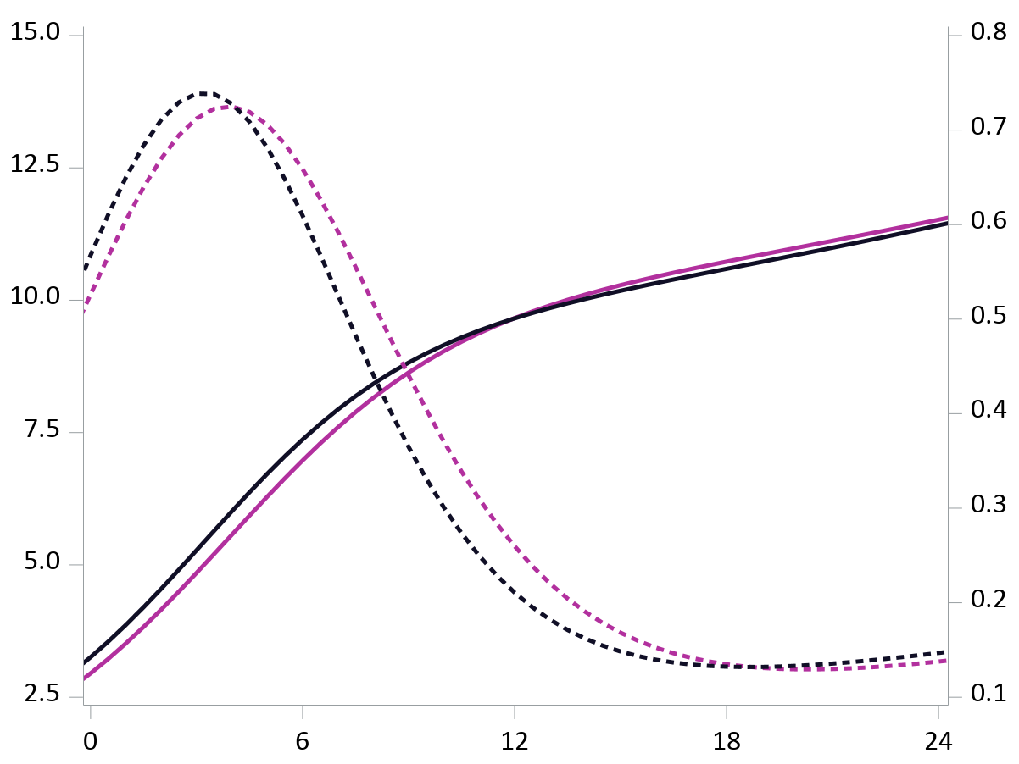

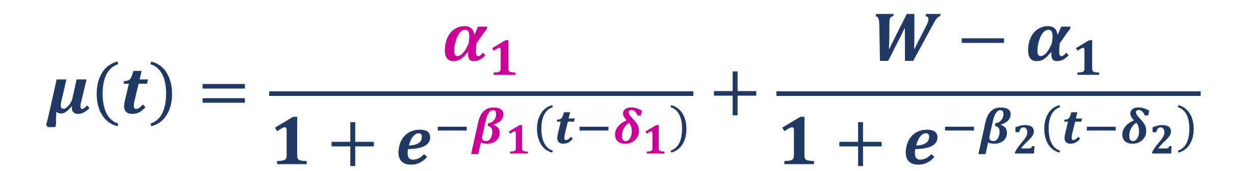
Moving Beyond Birthweight: Examining Developmental Origins of Disease Using Dynamic Postnatal Growth Indicators
Eva Tanner¹, Carl-Gustaf Bornehag^{1,2}, Chris Gennings¹
¹Icahn School of Medicine at Mount Sinai, NY, NY
²Karlstad University, Karlstad, Sweden
Conclusion
NOVEL NONLINEAR MODEL APPLICATION
EXPLAINS SHIFTING PFOA-INDUCED
CHILD GROWTH PATTERNS
Background
Results
Most prenatal exposure and growth studies use cumulative outcome measures (e.g. weight, BMI)
PFOA related to lower birthweight, but higher weight later on
Observed vs. Predicted Weight & Weight Velocity
for an Average SELMA Child
Methods
Modeled weight trajectory from birth to 5.5 years among 1334 children in the SELMA Study
$$μ\left(t\right)=\frac{α_{1}}{1+e^{−β_{1}\left(t−δ_{1}\right)}}+\frac{{W−α}_{1}}{1+e^{−β_{2}\left(t−δ_{2}\right)}}$$
Weight (kg)
Weight Velocity (kg/month)
Double Logistic Model
Age (months)
Infant
Peak Growth Velocity
(PGV)
Weight
Inflection Point
(δ₁,½α₁)
Average Predicted Weight & Weight Velocity Trajectories
for 10^{th%} vs. 90th% PFOA Levels
α₁
High
PFOA
β₁
Weight Velocity
Weight (kg)
Low
PFOA
Weight Velocity (kg/month)
δ₁
∆t₁
Time
Assessed prenatal PFOA exposure in relation to growth
Infant PGV
Age at infant PGV (δ₁)
Infant growth spurt length (∆t₁)
Post-spurt weight plateau (α₁)
Age (months)
Discussion
More Info
PFOA-induced low birthweight followed by delayed PGV (δ₁), longer infant growth spurt (∆t₁), higher post-spurt weight (α₁)
Nonlinear model useful to identify shifting growth patterns
Future studies can extract additional dynamic growth metrics
Eva.Tanner@mssm.edu
SELMASTUDIEN.SE

Slide 2
International Society for Environmental Epidemiology 2019 Conference Poster Utrecht, Netherlands
References:
Bock RD, Wainer H, Petersen A, Thissen D, Murray J, Roche A. 1973. A parameterization for individual human growth curves. Hum Biol 45: 63–80.
Bornehag C-G, Moniruzzaman S, Larsson M, Lindström CB, Hasselgren M, Bodin A, et al. 2012. The SELMA Study: A Birth Cohort Study in Sweden Following More Than 2000 Mother-Child Pairs. Paediatr Perinat Epidemiol 26:456–467; doi:10.1111/j.1365-3016.2012.01314.x.
Gyllenhammar I, Diderholm B, Gustafsson J, Berger U, Ridefelt P, Benskin JP, et al. 2018. Perfluoroalkyl acid levels in first-time mothers in relation to offspring weight gain and growth. Environ Int 111:191–199; doi:10.1016/j.envint.2017.12.002.
Høyer BB, Ramlau-Hansen CH, Vrijheid M, Valvi D, Pedersen HS, Zviezdai V, et al. 2015. Anthropometry in 5- to 9-Year-Old Greenlandic and Ukrainian Children in Relation to Prenatal Exposure to Perfluorinated Alkyl Substances. Environ Health Perspect 123:841–846; doi:10.1289/ehp.1408881.
Lauritzen HB, Larose TL, Øien T, Sandanger TM, Odland JO, Van De Bor M, et al. 2018. Prenatal exposure to persistent organic pollutants and child overweight/obesity at 5-year follow-up: A prospective cohort study. Environ Heal A Glob Access Sci Source 17:1–12; doi:10.1186/s12940-017-0338-x.
Maisonet M, Terrell ML, McGeehin MA, Christensen KY, Holmes A, Calafat AM, et al. 2012. Maternal concentrations of polyfluoroalkyl compounds during pregnancy and fetal and postnatal growth in British girls. Environ Health Perspect 120:1432–7; doi:10.1289/ehp.1003096.
Negri E, Metruccio F, Guercio V, Tosti L, Benfenati E, Bonzi R, et al. 2017. Exposure to PFOA and PFOS and fetal growth: a critical merging of toxicological and epidemiological data. Crit Rev Toxicol 47:482–508; doi:10.1080/10408444.2016.1271972.

